Slide 1
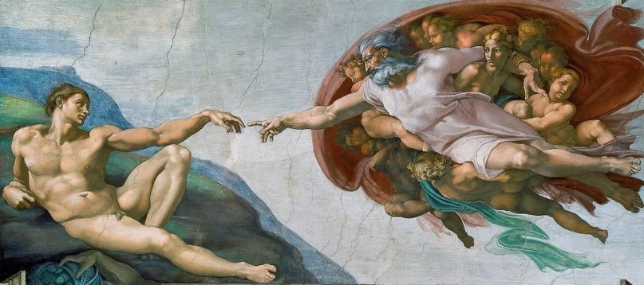
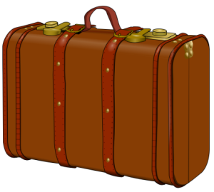
Art & the sacred
The Luggage Box
Rev. 170919

Slide 2

BIG
MOVIE
We are proposing a big movie.
ART & THE SACRED: A Pilgrim’s Progress, but even a Pilgrim needs some luggage. This Powerpoint hopes to be a dialog.
What luggage do we need to travel
To the Sacred
By our Art?

Slide 3

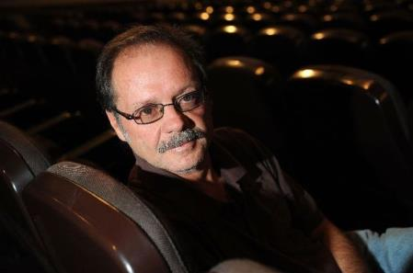
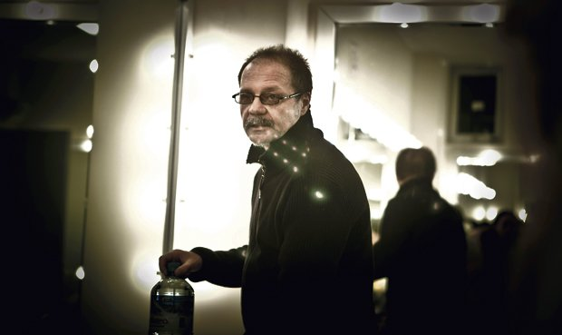

Slide 4

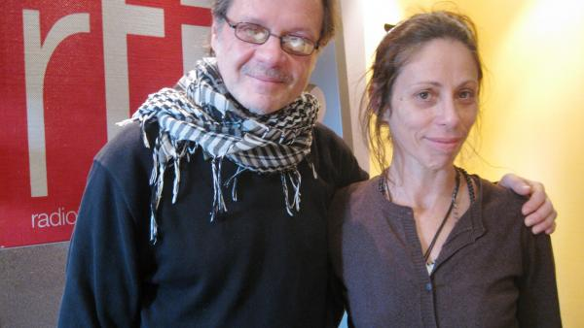
Oscar – Anna
INTEGRO
Oscar (Natars Burger) & his very esteemed wife and artistic partner, Anna Zavala, make the essence of Integro. Based in Peru they have presented all over the world and recently won Director of the Year from the Hispano-American Critics Association.

Slide 5
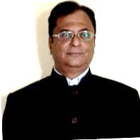
Dr. Kalyan Kumar Cakravarty
Former Director of Primary Education, Madhya Pradesha, (India); Director Lalita-kala Academy, India’s national fine arts academy; PhD Harvard in museum management; insightful author, poet, art historian.

Slide 6
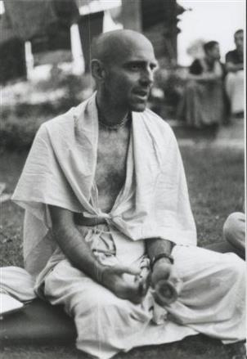
Hanumat-presaka
Swami
Born, Jan 12 1948, Guam (Marianas Islands). Grew up in Arizona, California. Graduated 1st place in Psychology, 1970, U.C. and headed East . . . Okinawan Karate, Bengali Monk . . . Co-founder of NIOS (North American Institute for Oriental and Classical Studies).

Slide 7
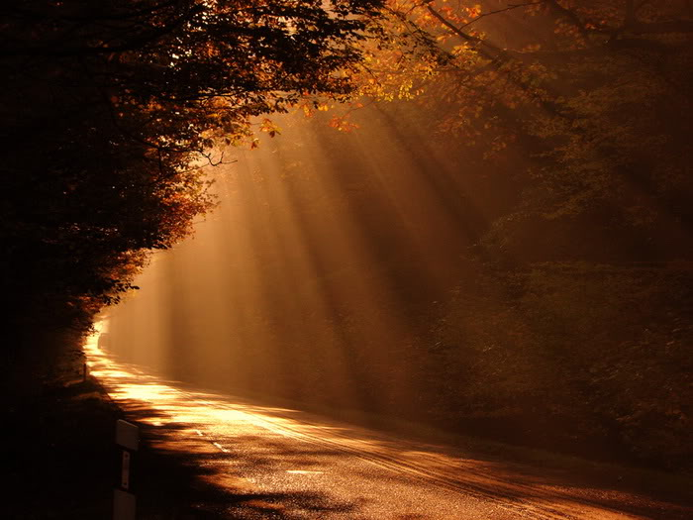


Slide 8
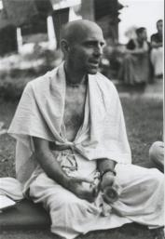
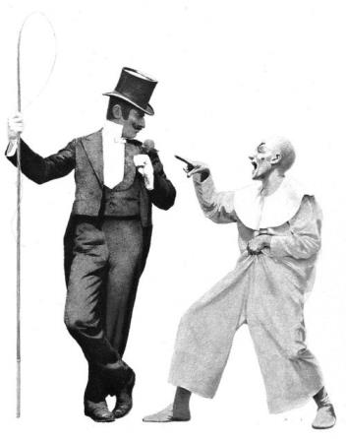


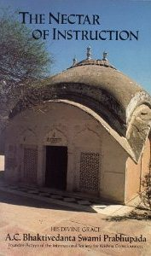

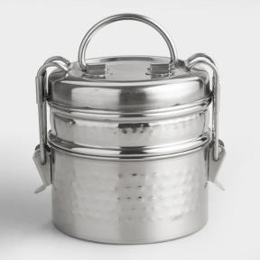
We want to pack for the trip:
Wry sense of humour.
The Nectar of Instruction of A. C. Bhaktivedanta Swami.
Lunch Can.

Slide 9
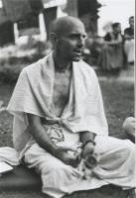
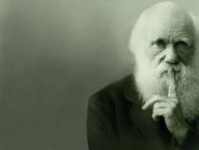

We hope Dr. Kalyan brings his profound perspective on cross cultural anthropology. We are nurtured in this by Prof. Marshal McLuhan and Prof. E. T. Hall.
Prof. Hall suggests that the United States, industrialized society, is dominated by Northern German consciousness. This leads us to look at nature as our enemy to be conquered, controlled, exploited, by the use of iron tools, powerful drugs, and thus our agriculture becomes based upon soil sterilization, injecting seeds with iron needles, artificial irrigation, artficial fertilizer, and of course . . . artificial food.
Following the Bhagavata perspective, first there is the ego, why I do things. This generates our perspective, Buddhi, understanding. On this basis we think, plan, evaluate and finally we become entangled in different bodies life after life.

Slide 10
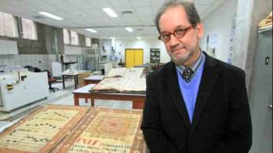
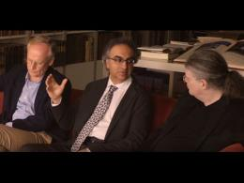
Who’s on the bus?
Where are we going?
Why are we going there?
Hector Behar.
Samaresh Bandhyopadyay.
Ravi Gupta.
. . . . . . . . . . . . . . .
. . . . . . . …. . . …
. . .. . .. .. .
Ramon Mujica
Shonu Sham Dasani

Slide 11
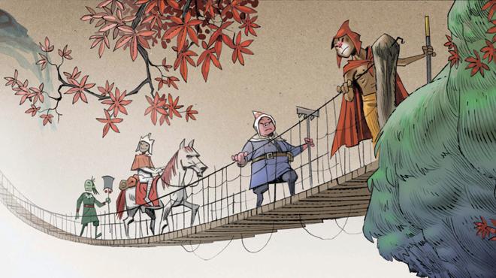
Your
turn…

Slide 12
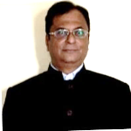
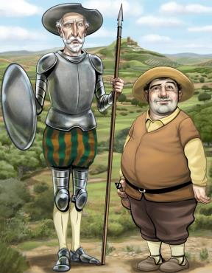
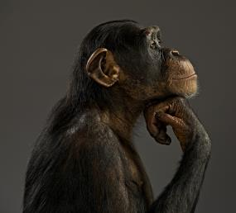
Esteemed Swamiji,
Best to offer quick, gut reactions rather than studied texts on this preliminary sortie on the Power Point.

Slide 13
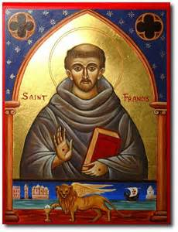
If we are to have mixed metaphors, we need to join images from East and West. Examples, Kumbh Mela, a pilgrim with a sack on head on way to Kedarnath, Ramakrishna standing in samadhi , a monk in the tradition of St Francis of Assisi.

Slide 14
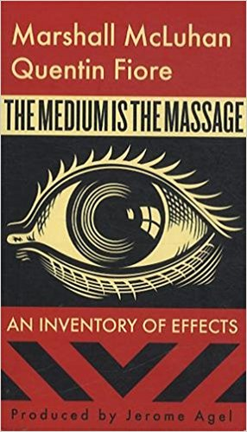
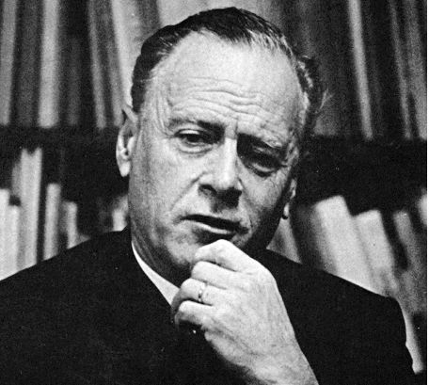
McLuhan, yes. But to demonstrate that technology is to be extension, not master of man. Images from the world of Medicine, Food. Artificial would include Artificial Intelligence, to avoid substitution of Real by Virtual

Slide 15
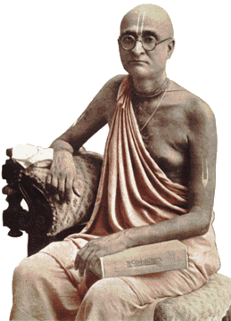
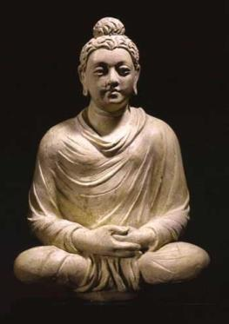
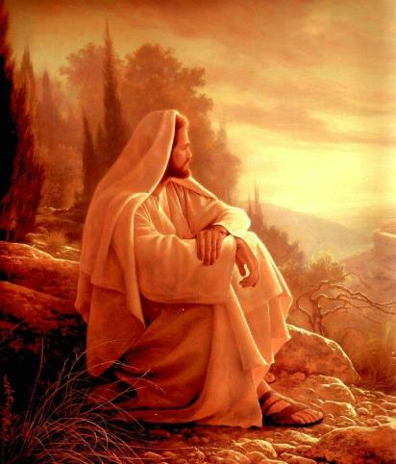


Examples not only of the journey, or pilgrims who have undertaken it, but also of those that have reached or sighted the goal. Prabhupada, Buddha , Christ come to mind.

Slide 16
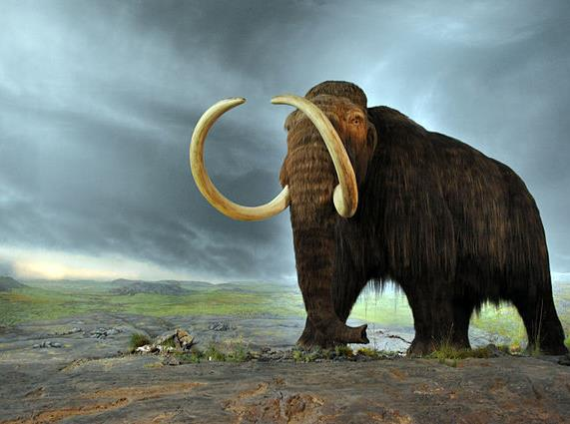
The objective should be clear. The Sacred is not rituals or chants, but an urgent need to overcome clear and present dangers of extinction, to avert the day of reckoning.

Slide 17
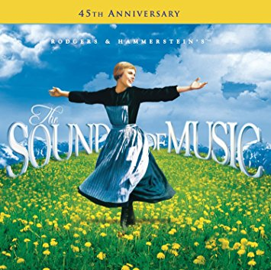
Music, and music of the sea, birds, forest, Beethoven's 9th Symphony come to mind.
https://www.youtube.com/watch?v=AePRD1Ud3Lw&t=77s

Slide 18

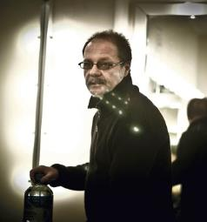
Hare Krsna!
Dear Maharaj, here I am sending information about The Art & The Sacred.
These are a couple of reflexions (reflexiones?) of
Alonso del Rio, with whom I am doing Vision Quest and with whom I am celebrating ceremonies with sacred plants 25 years ago.
I fully agree with these ideas but I suspect that the translation is not the best, cause I did it by internet. Anyway I hope it is clear enough. I am sending the document both in english and spanish.
I am waiting for tomorrow Mr. Bejar s ideas, and also Eduardo Gastelumendi,
Thank you
Oscar

Slide 19
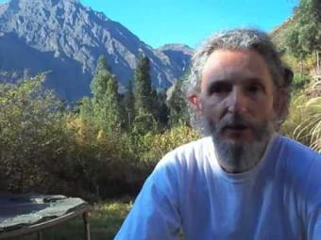
Alonso Del Río
https://es.wikipedia.org/wiki/Alonso_Del_R%C3%ADo
Art and society (Alonso del Rio - The Four Altars)
Since time immemorial, art has been revered as something sacred, because people intuited that it not only touches our depths but also heals them. Then a society without true art is a sick society. Art speaks to the heart, intuition but also the mind, touches the two cerebral hemispheres and something magical happens that the human being feels complete, whole, total. A person who does not produce or does not enjoy beauty becomes ill.

Slide 20
The only difference between true and false is often motivation. If the motivation is existential, visceral or if the motivation is a cold calculation of how much I can win by producing something that can be sold as art. Let's look at how the “Matrix” works: By not
having access to the real world, to the sacred world, what they do is to create something very similar (they are experts imitating), create something as close as they can in all the dimensions and categories in which they try to supplant life. Thus they create pseudo-art, pseudo-spirituality, pseudo-liberation.
The saddest thing is that both master plants, art and religion - which are the sacred and natural doors to escape slavery and the system itself - have already been cloned and their crude version traps and deceives millions of good people scammed by pseudo-Shamans or pseudo-gurus.

Slide 21
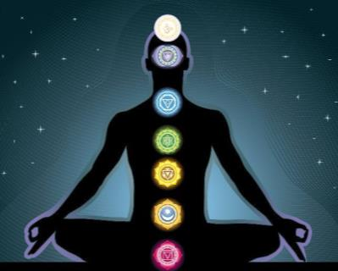
Money, sex and power, the energies that motivate our first three chakras, captivate and corrode even the purest intentions of those who have not come to know the treasure of their own heart (fourth level). True art brings me to science and true science gives me art.

Slide 22
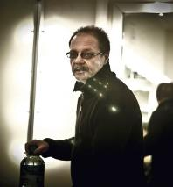
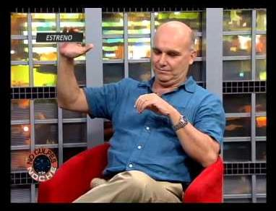
Hare Krsna!
Here adjunt Eduardo Gastelumendi ideas.
Please try to do not so long interviews. Ask for sinthesis.
Thank you, Oscar
Eduardo Gastelumendi (Peru)
Médico, psiquiatra y psicoanalista Miembro de la Asociación Neuro-psiquiátrica Internacional.
Presidente de la Asociación Psiquiátrica Peruana (1999 – 2000) y de la Sociedad Peruana de Psicoanálisis (2014 – 2016).
Miembro fundador de Takiwasi (1992, Tarapoto, Perú).

Slide 23
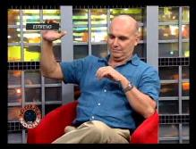
The most sacred is life, the life thought and felt by a being who has consciousness. Consciousness allows us to glimpse the sacredness of everything that exists.
But daily, automated life, away from the deepest consciousness, our contact with the sacred. Rituals are a way of reminding us of that other reality that exists, as well as the practices that lead us to modify states of consciousness, to expand them. And also art, like poetry and music. And the dance, the theater, the plastic arts? Those are areas where you are a teacher. How do these arts remind us of the sacred?
The sacred transcendence in immanence: There is in us the possibility of relating to the sacred (with the "holy", would say Rudolf Otto.) Do you know his book Das Heilige, I have it if you want to read it. Art is a means to awaken consciousness to it. Not all art, of course. This can be a dialogue, Oscar. Tell me what you think.
Eduardo

Slide 24
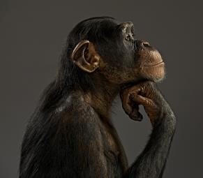
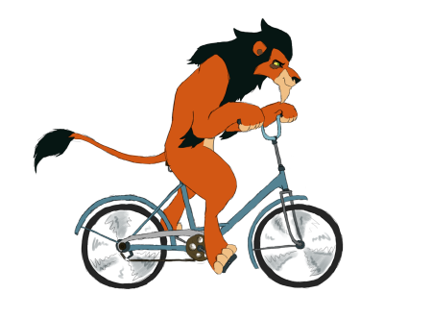
“The most sacred is life, the life thought and felt by a being who has consciousness. Consciousness allows us to glimpse the sacredness of everything that exists. “
Hmmm. Five elements: Feelings, Thoughts, Consciousness, The Being, Environs!
Sanskrit: Indriya, Manas, Bhava, Atma, Virata-rupa?
[https://www.vedabase.com/en/bg/7/4]

Slide 25
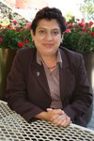
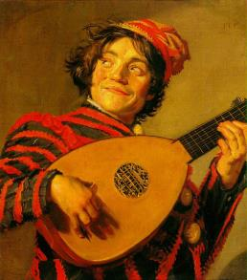
Dr. Dolores Chavez
Senior Professor of Cultural Anthropology, Monterey Tech University, Mexico
"¿Por qué es tan mágica la música? ¿Por qué
las revelaciones espirituales y los modos de
conciencia más profundos se alcanzan
tradicionalmente a través del canto, cuando
se emite y recibe ciertos esquemas
musicales? La antigua y perdurable respuesta
es que la música es un eco del impulso
original de la creación divina"
Stewart, R.F. (1990:47; Música y conciencia, España, Mandala ediciones.)

Slide 26
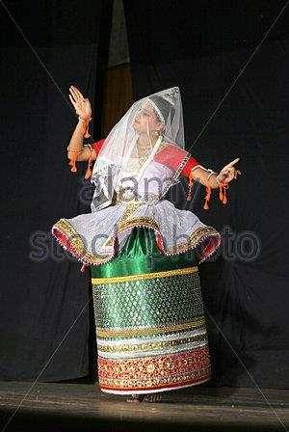
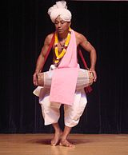
Why is music so magical?
Why spiritual revelations and modes of awareness are reached traditionally through singing, when they emit and accept certain musical schemata?
The ancient and enduring answer is that music is an echo of the original momentum of divine creation.
Stewart, R.F. (1990: 47; Music and Consciousness, Spain, Mandala editions.)

Slide 27
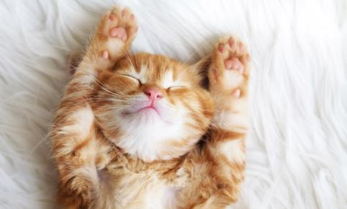
We are pooped!
But if you want to scratch a little bit you can find the original article from Oscar et al, and two excellent essays from Dr. K. K. C at: http://www.jayarama.us/archives/art-sacred/

Slide 28
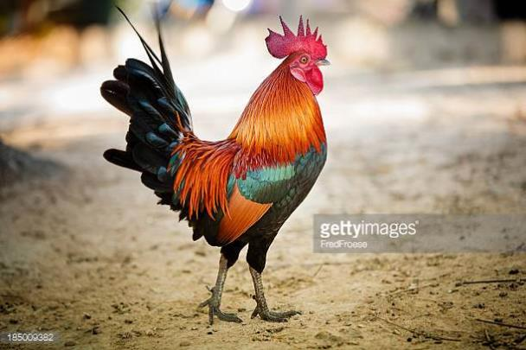
We want to pack for the trip:
Wry sense of humour.
The Nectar of Instruction of A. C. Bhakti-vedanta Swami.
Lunch Can.
Nobody else is going on the trip?
We have wonderfully discussed the goal, the problem, the boat, but nobody else is packing for the journey?
Are Monkey and Piggy coming? Eduardo’s Rooster?

Slide 29

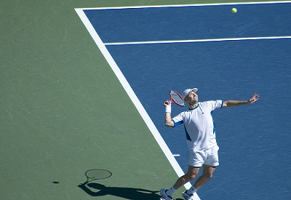
Your Turn
End of Set?

