Slide 1
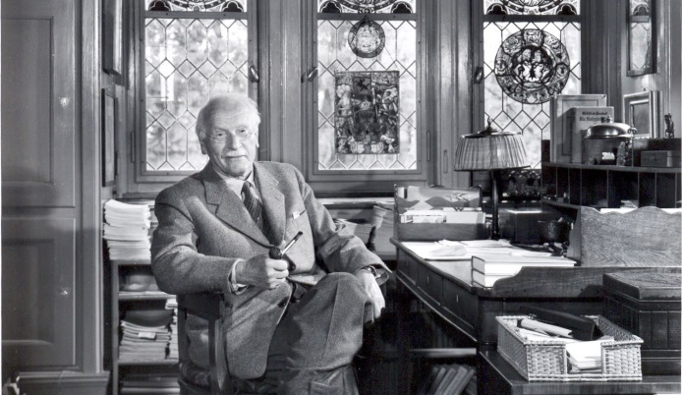

Psychotherapy
&
Meditation
2018 September 18
Boise State University
Modern Treatment of Psychiatric Disease
(PSYC 497)
www.JayaRama.US

Slide 2
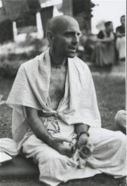
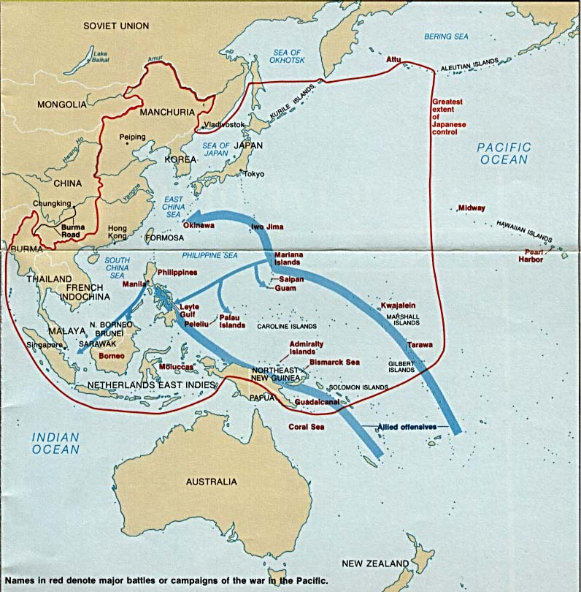

Hanumatpresaka Swami
H. H. Robinson
January 1948
Guam, Marianas Islands
Notes:
But before that a short biography of ourselves -- a little biography of the biographer. We are H. H. Robinson, Hanumatpresaka Swami, We were born January 1948 on the Pacific Island of Guam, but less than a year old we came with our parents to the United States.

Slide 3
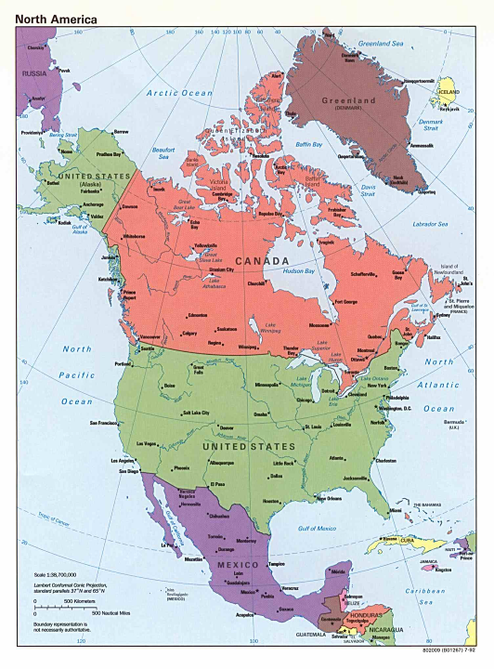
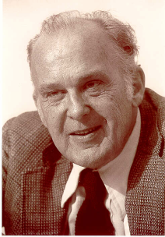
University of California
Electrical Engineering
Biological Engineering
Psychology, ФВҚ
North-Western University
Mentor Donald T. Campbell
Second City Theater
Okinawa Karate
Bengali Vaisnava 1974

Slide 4
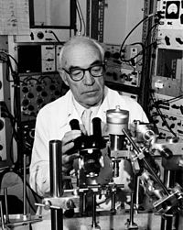
Bhaktivedanta Institute
World Congress for Synthesis of Science and Religion 1986
George Wald,
Charles Townes
Dalai Lama
First International Seminar on the Study of Consciousness within Science 1990
Sir John Eccles
George Wald

Slide 5
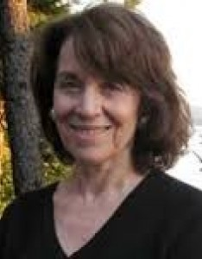
NIOS (North American Institute for Oriental and Classical Studies)
Contribution of Ancient India Toward Making a Better World
Indian National Museum, Kolkata, 2012
Mukundakam Sharma
Governor West Bengal
Dmitri Kitsikis
Psychology and the Sacred
National Library of Peru, 2016, 2017.
Eduardo Gastelemundi
Ramon Mujica
Beverly Zabrieskii

Slide 6
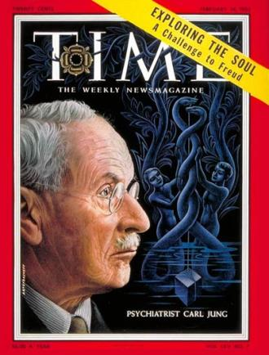
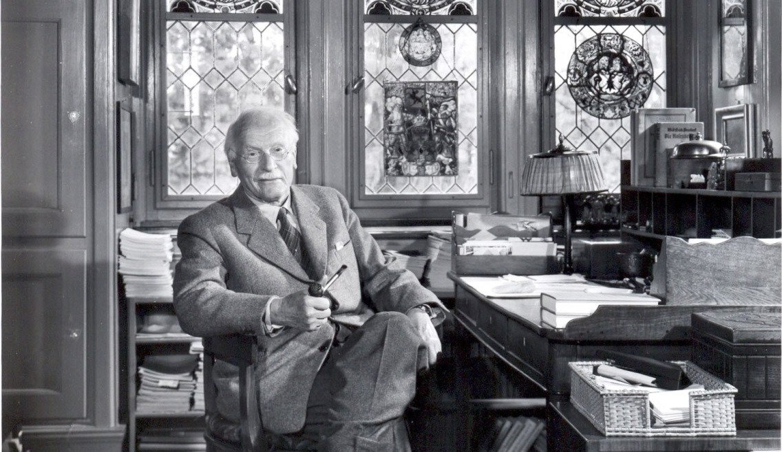
Philemon Foundation
Sonu Shamdasani
The Psychology of Kundalini Yoga: Notes of the Seminar Given in 1932

Slide 7
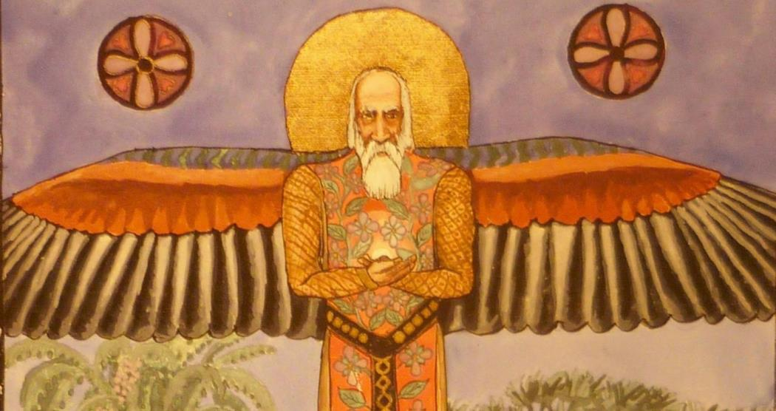
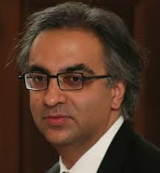
Tavistock Lectures
Memories, Dreams and Reflections (Auto Biography)
Jung and the Making of Modern Psychology: The Dream of a Science

Slide 8

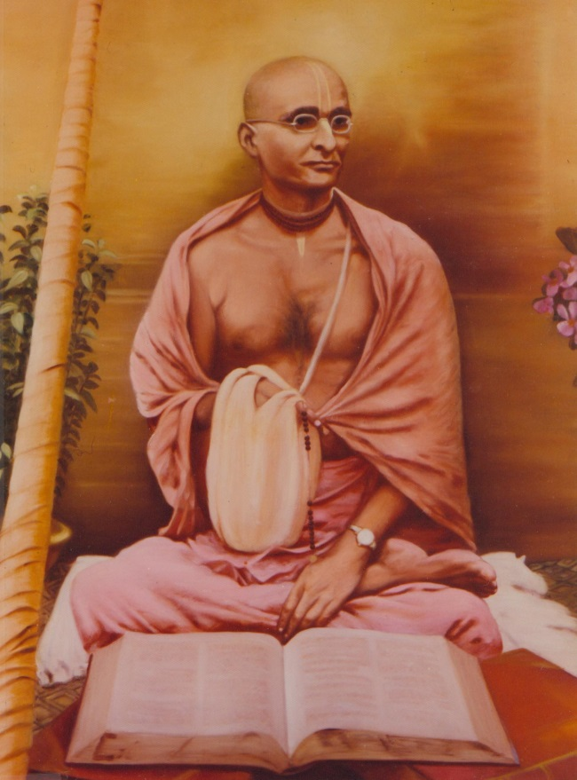
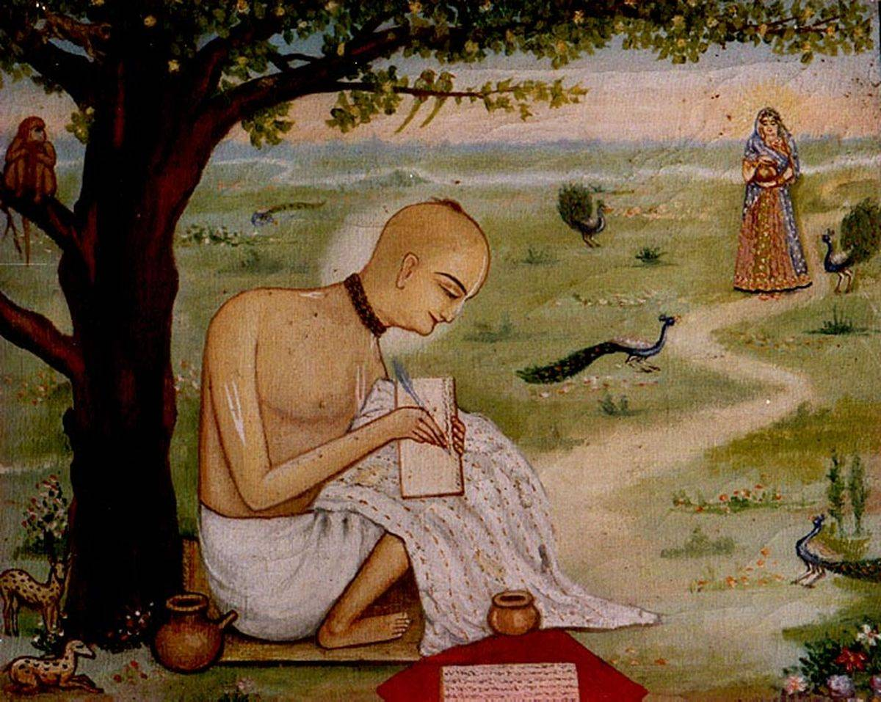
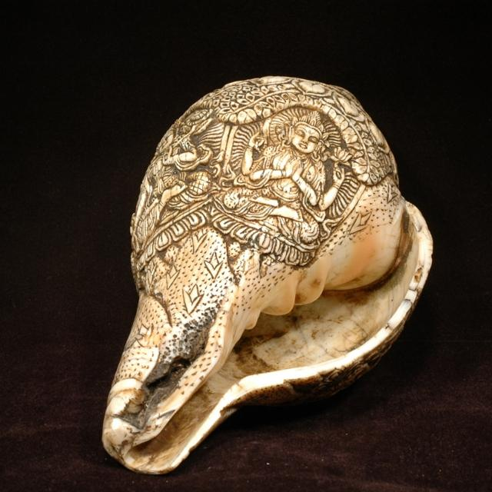
INDIA
Another World

Slide 9
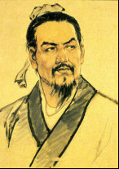
“... if you go to other races, to India or China, for example, you discover that these people are conscious of things for which the psychoanalyst in our countries has to dig for months.”
“We Europeans are not the only people on the earth. We are just a peninsula of Asia, and on that continent there are old civilizations where people have trained their minds in introspective psychology for thousands of years, whereas we began with our psychology not even yesterday but only this morning. These people have an insight that is simply fabulous...”
Jung, C. G.; Analytical Psychology, Its Theory & Practice; Vintage Books, 1970, pages 48 & 74

Slide 10
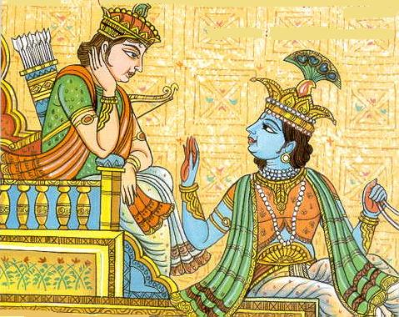
Bhagavad-Gita
Bg 7.4
bhūmir āpo ’nalo vāyuḥ
khaṁ mano buddhir eva ca
ahaṅkāra itīyaṁ me
bhinnā prakṛtir aṣṭadhā

Slide 11
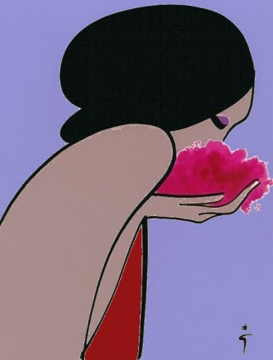


earth,
water,
ﬁre,
air,
ether,
mind,
intelligence and
false ego
All together these eight constitute My separated material energies.

Slide 12
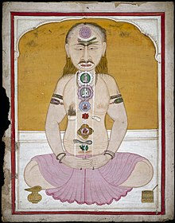
Kundalini

Slide 13

Sildenafil citrate – Viagra
Onion, Garlic
Mantra
Aum Mani Padme Hum
Om Namo Bhagavate Vasudevaya
Domine Iesu Christe, Fili Dei, miserere mei, peccatoris

Slide 14
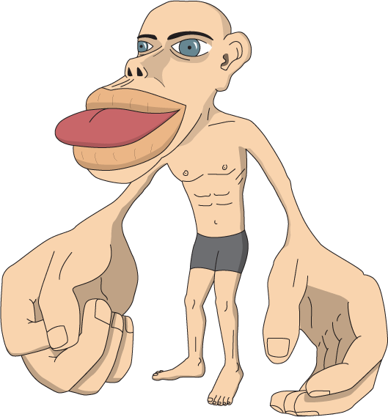
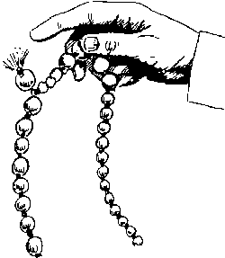
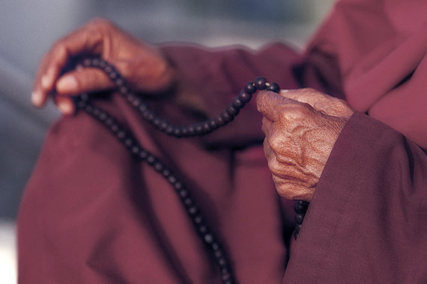
Japa, Rosary, Chanting on Beads

Slide 15
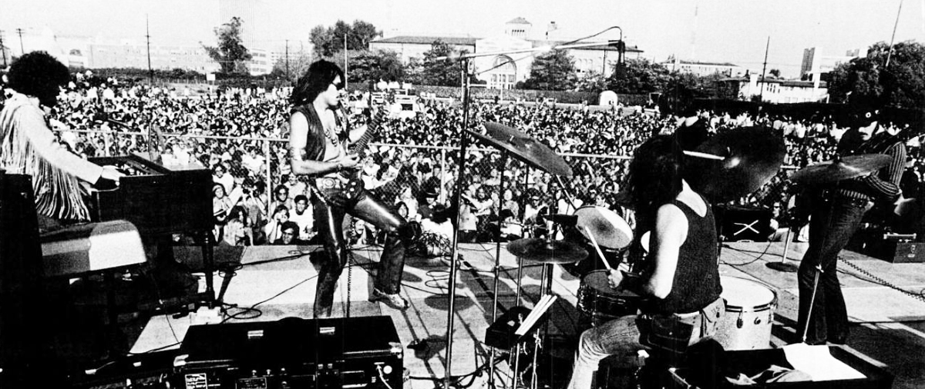
Music, Dancing
Spatial Orientation
Temporal Discrimination
Tonal Discirminiation
Meaning.
Steppen Wolf
The Pusher

Slide 16
"The Pusher"
You know I've smoked a lot of grass
O' Lord, I've popped a lot of pills
But I never touched nothin'
That my spirit could kill
You know, I've seen a lot of people walkin' 'round
With tombstones in their eyes
But the pusher don't care
Ah, if you live or if you die
God damn, The Pusher
God damn, I say The Pusher
I said God damn, God damn The Pusher man

Slide 17
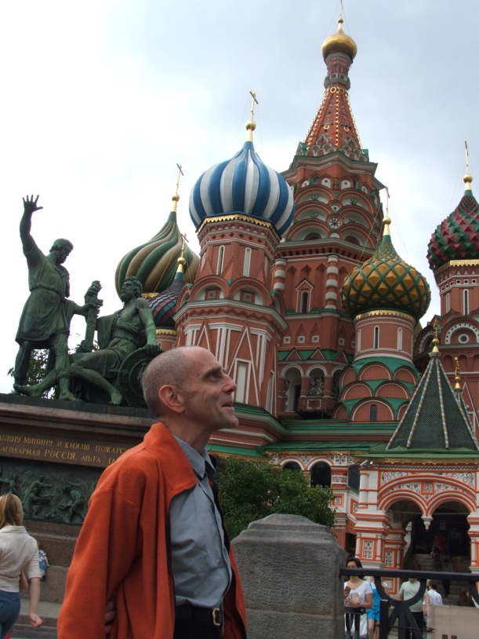
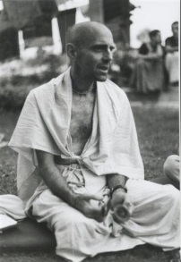
Thank
You
Prof. Huber H. Robinson
www.NiosNimbus.org
Hanumatpresaka Swami
www.JayaRama.us

